Slide 1
Logistics: Project
Project presentation
Dec 6/8 during lectures
Everyone is expected to attend both lectures
10 minutes for presentation + 1~2 minutes for QA and transition
Project reports
Due: Dec 9 (no late submissions)
Up to 6 pages (plus additional pages for only references/citations)
No strict format requirements
You are encouraged to use standard templates
Check Piazza posts for details/updates

Slide 2
Assignment 4
No class on Nov 22, Tuesday (thanksgiving week)
Instead, I’ll give a list of talks/tutorials relevant to this course.
Choose one of them, watch the content, and write a report
The report needs to be no less than 2 pages, with any reasonable format
The report will serve as your assignment 4
More details will be announced next week

Slide 3
Peer Review
Please submit the peer review by 6pm

Slide 4
Lecture 20 Continue on Ethical Decision Making: Computational Social Choice
Instructor: Chien-Ju (CJ) Ho

Slide 5
Algorithmic Ethical Decision Making
A Top-Down Approach
Extending game theory / decision theory to incorporate ethics
Define what you mean by being ethical
Wire that in into the algorithm design
If you can write down the “moral” utility…

Slide 6

Asimov’s Three Laws of Robotics
First Law: A robot may not injure a human being or, through inaction, allow a human being to come to harm.
Second Law: A robot must obey the orders given it by human beings except where such orders would conflict with the First Law.
Third Law: A robot must protect its own existence as long as such protection does not conflict with the First or Second Law.

Slide 7
Algorithmic Ethical Decision Making
Trust Game
Two players: Alice and Bob
Game flow
Alice receives 100 dollars and can decide to give back X dollars
Bob will then receive 3 * X dollars and can decide to give Alice Y dollars
What’s the equilibrium?
X = Y = 0
In practice, people do give back money [Berg, Dickhaut, and McCabe 1995]
It feels morally wrong to not give some money back
If we can quantify this sense of moral, we can incorporate that in the utility
It’s usually really hard to do so and everyone is different

Slide 8


A Related Concept
A utility maximizing algorithm that respects given moral principles
It can often be equivalently represented as follows [Using Lagrangian idea in convex optimization]
Informally, these ethical/fairness discussions often lead to defining new utility functions
maximizing $utility(action)$
subject to moral principles
maximize $utility\left(action\right)−λ∗[\text{moral} \text{principles}\text{]}$

Slide 9
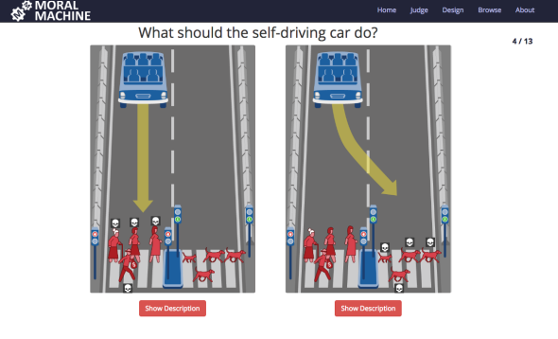
Algorithmic Ethical Decision Making
A Bottom-Up Approach
Learning/summarizing from human judgements
Collect data sets of human judgments
Apply machine learning
Make decision based on predictions

Slide 10
Incorporating Preferences from Stakeholders
WeBuildAI: A Participatory Approach [Lee et al. 2019]

Slide 11
What if People Disagree?
Social choice theory
Given a set of preferences on actions, what is the action we should take?

Slide 12
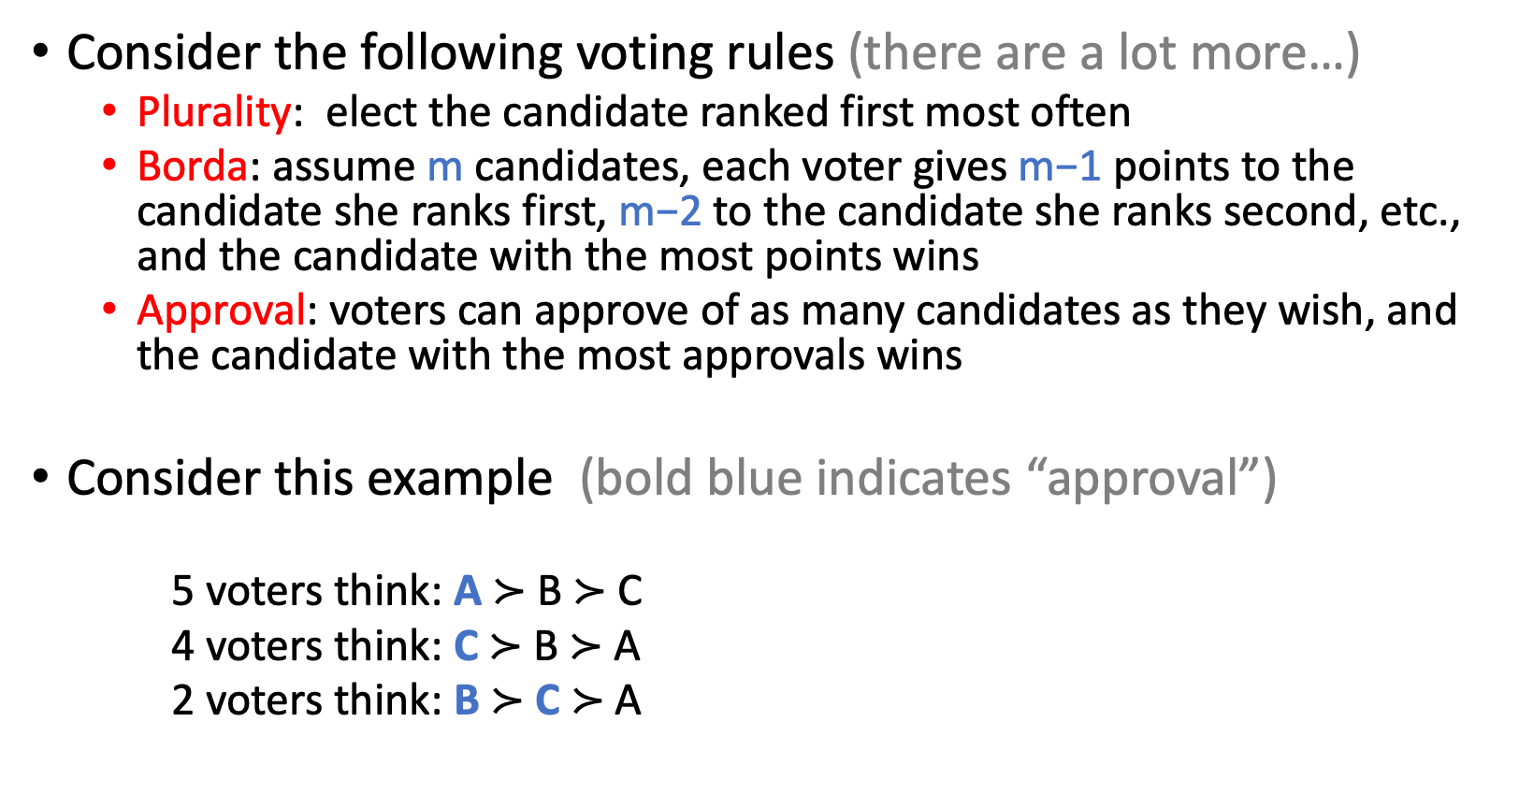
Voting – One Common Form of Social Choice
Consider the following voting rules (there are a lot more…)
Plurality: elect the candidate ranked first most often
Borda: assume m candidates, each voter gives m−1 points to the candidate she ranks first, m−2 to the candidate she ranks second, etc., and the candidate with the most points wins
Approval: voters can approve of as many candidates as they wish, and the candidate with the most approvals wins
Consider this example (bold blue indicates “approval”)
5 voters think: A $≻$ B $≻$ C
4 voters think: C $≻$ B $≻$ A
2 voters think: B $≻$ C $≻$ A
Who wins the election for each of the voting rule?

Slide 13
We need to be very clear about what properties we are looking for

Slide 14
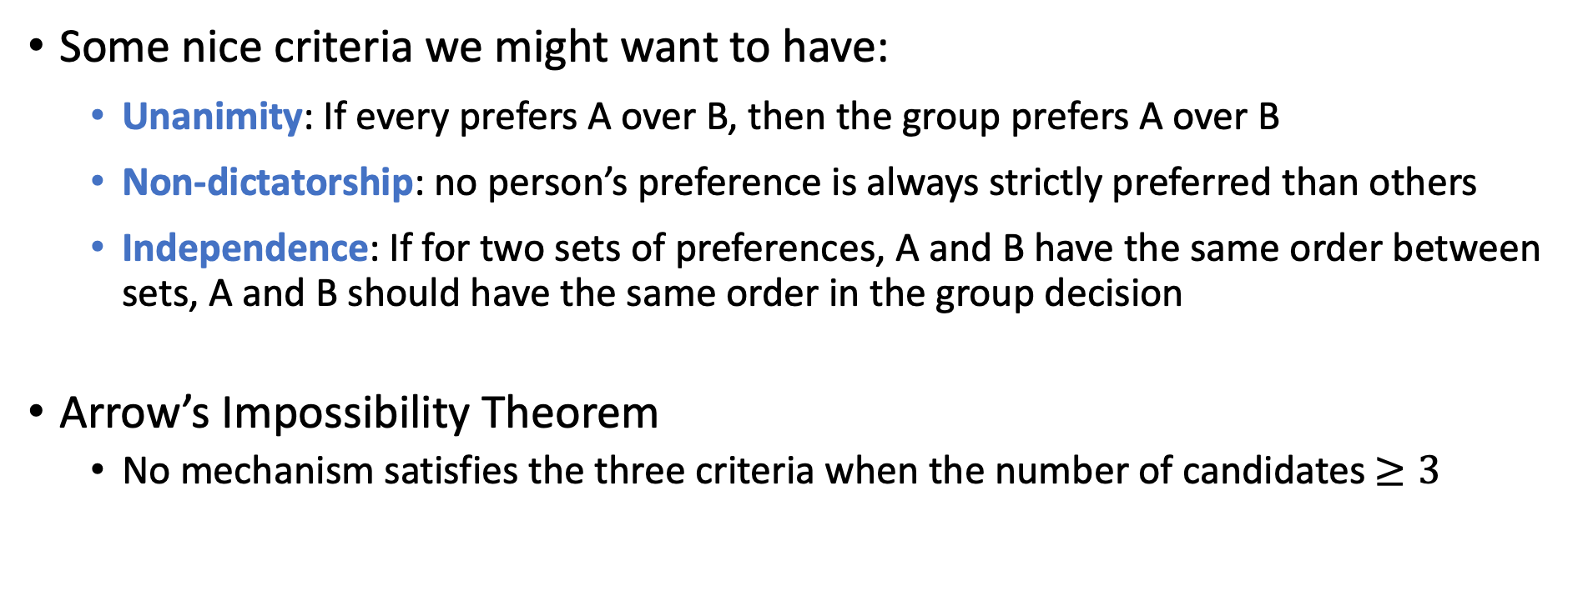
Arrow’s Impossibility Theorem
Some nice criteria we might want to have:
Unanimity: If every prefers A over B, then the group prefers A over B
Non-dictatorship: no person’s preference is always strictly preferred than others
Independence: If for two sets of preferences, A and B have the same order between sets, A and B should have the same order in the group decision
Arrow’s Impossibility Theorem
No mechanism satisfies the three criteria when the number of candidates $≥3$

Slide 15
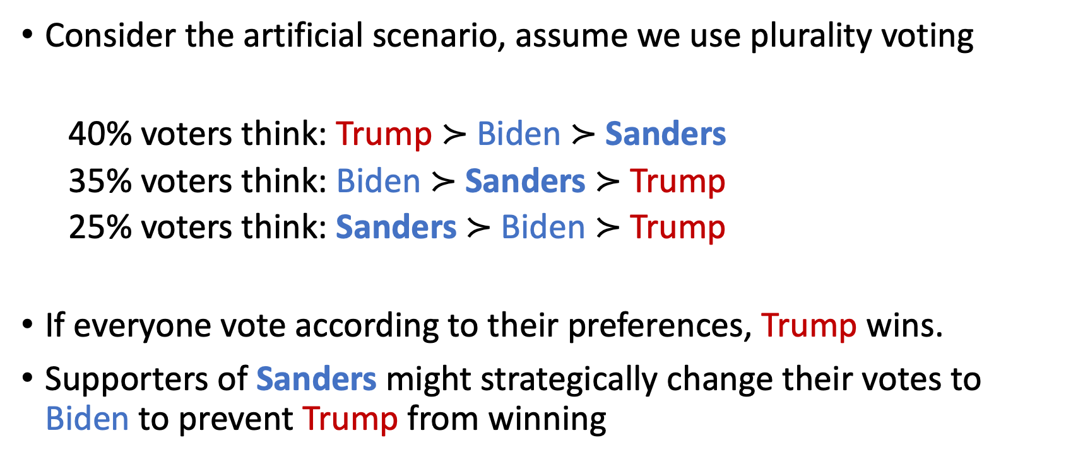
Things could be even more complex
Consider the artificial scenario, assume we use plurality voting
40% voters think: Trump $≻$ Biden $≻$ Sanders
35% voters think: Biden $≻$ Sanders $≻$ Trump
25% voters think: Sanders $≻$ Biden $≻$ Trump
If everyone vote according to their preferences, Trump wins.
Supporters of Sanders might strategically change their votes to Biden to prevent Trump from winning

Slide 16
Axiom Based Approach
Define a set of axioms that we like
Unanimity, Non-dictatorship, Independence, Strategy-proof,…
They can’t be satisfied simultaneously
Trade-off is required (sounds familiar….)
Common approaches
Pick a subset to satisfy => leading to different mechanisms (voting rules)
More CS-style approach: allow some properties to be “approximately” satisfied
Crowdsourcing the trade-offs
(then often again leading to new trade-offs….)

